Slide 1

Grounding Language Models for Compositional and Spatial Reasoning
Master Thesis: Master in Language Analysis and Processing
Author: Julen Etxaniz
Advisors: Oier Lopez de Lacalle & Aitor Soroa
Departments: Computer Systems and Languages &
Computational Science and Artificial Intelligence
Date: October 2022

Slide 2
1 Introduction
Language models (LMs) have impressive capabilities in many tasks
Pre-train and fine-tune to avoid training from scratch
However, LMs criticized for lack of meaning
Grounding necessary for human-like language understanding
Compositional and spatial reasoning are challenging for LMs
Vision and Language Models (VLMs) are pre-trained on image-text pairs
VLMs better than LMs, but still struggle to ground spatial concepts
Text-to-image diffusion models have some visual reasoning skills
Diffusion models struggle to ground composition
Mistakes: attribute leakage, interchanged attributes, missing objects

Slide 3
1.1 Objectives
Three main objectives and sections
Improve the state-of-the-art in compositional reasoning
Winoground zero-shot models not much better than chance, far from humans
We extend experiments with more pre-trained and fine-tuned models
Perform zero-shot experiments in spatial reasoning
VSR fine-tuning large performance gap between models and humans
We extend experiments with zero-shot fine-tuned on NLVR2
Investigate the use of synthetic datasets to overcome the lack of data
Text-to-image Stable Diffusion to generate images from Winoground captions
Image captioning models to generate captions for Winoground images
Image retrieval systems to retrieve images of interest from a large dataset

Slide 4
2 Winoground Zero-shot Experiments
The Winoground paper only included zero-shot experiments with pre-trained models
We test more pre-trained models and get better results
We test models fine-tuned for specific tasks such as image-text retrieval and visual reasoning
We prove that fine-tuning helps to obtain better results than previous experiments

Slide 5
2.1 Winogrond Dataset
400 test examples to probe visio-linguistic compositional reasoning
Each one contains two images and captions, the goal is to match them
Both captions contain the same words in a different order
All examples are labelled with linguistic tags. 65 total, 3 main groups:
Object swaps consist in swapping noun phrases that refer to objects.
Relation swaps reorder words that refer to objects such as verbs, adjectives…
Both swaps involve changing both relations and objects.
Linguistic swap independent: 1 or 2 main predicates
Some examples have visual tags:
Pragmatics tag includes images that need to be interpreted non-literally
Series tag contains examples where both images come from the same photo series
Symbolic tag represents that the images include a symbolic representation

Slide 6
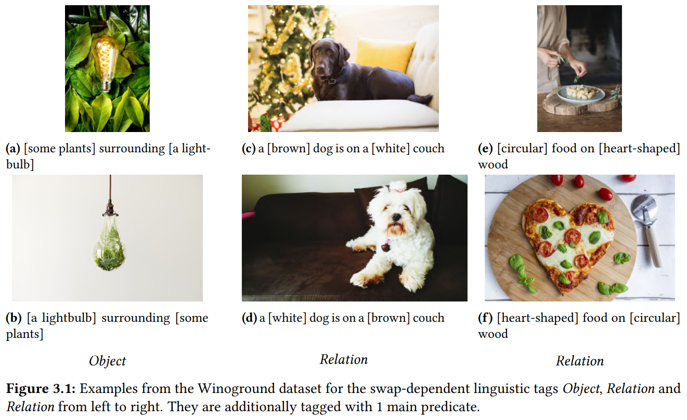

Slide 7
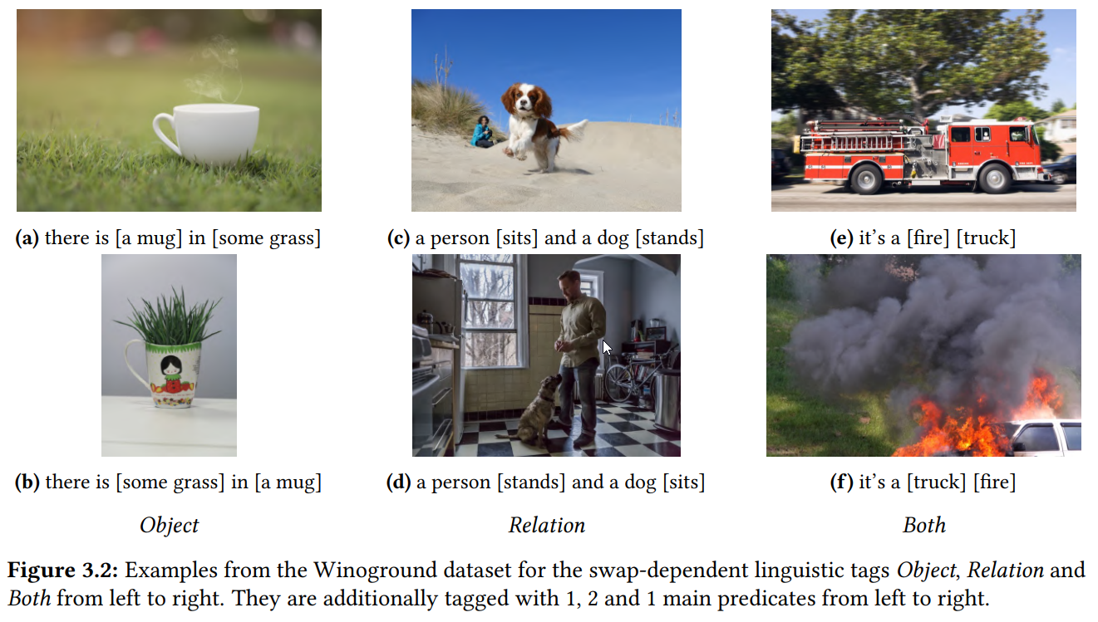

Slide 8
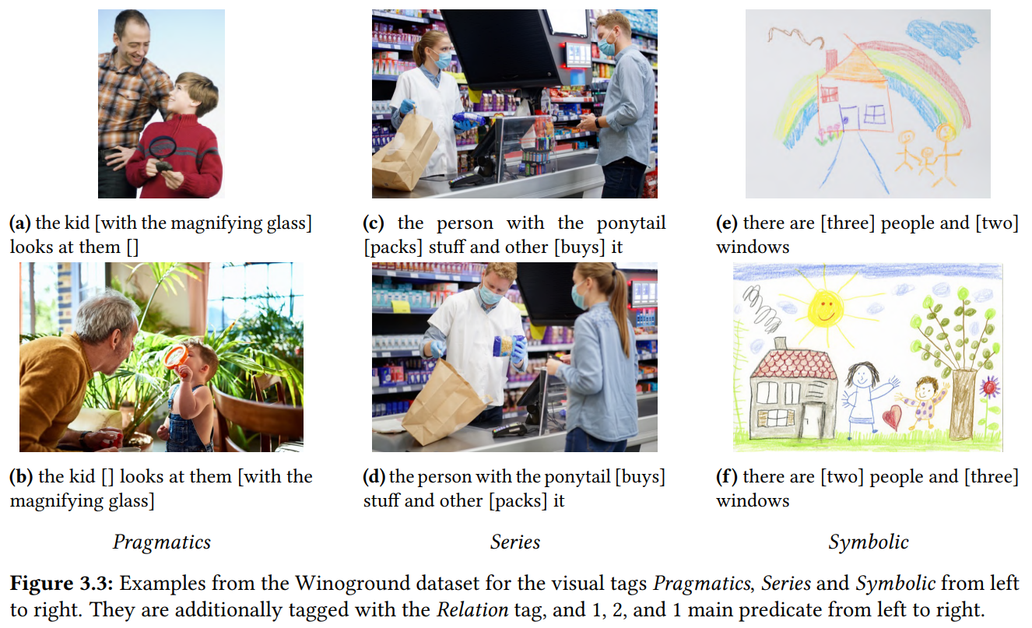

Slide 9
2.3 Experiments and Results
Previous: zero-shot experiments with pre-trained models
CLIP, FLAVA, LXMERT, UniT, UNITER, VILLA, VinVL, ViLT, VisualBERT and ViLBERT
Ours: zero-shot with pre-trained and fine-tuned models
OFA, BLIP, CLIP, FLAVA and ViLT
Humans around 90%, models close to or below random chance (25%)
Fine-tuning for retrieval and visual reasoning helps
BLIP better than previous models, 10% in text score, 4% in image score and 7% in group score
Text score: whether the model selects the correct caption given an image
Image score: whether the model selects the correct image given a caption
Group score: combines text and image score, all combinations correct
Still very far from humans, 40% gap in text scores, and 64% in image and group scores

Slide 10
2.3 Experiments and Results
Swap-dependent linguistic tags:
Humans highest scores on Object, followed by Relation and then Both
Models opposite, highest scores on Both, shortest and least compositional
Swap-independent linguistic tags:
Humans are better on 2 main predicates, longer and more complicated
Models opposite, best on 1 main predicate
Visual tags:
Humans (~95%) and models (40%) good at Symbolic
Humans very bad at Pragmatics (50%), good at Series (95%)
Models very bad on Pragmatics and Series (0% in image and group scores)

Slide 11
3 VSR Zero-shot Experiments
Visual Spatial Reasoning contains training and validation splits to train models
VSR authors train and test three popular VLMs: VisualBERT, LXMERT, and ViLT
We do zero-shot experiments with ViLT and BLIP fine-tuned on NLVR2

Slide 12
3.1 VSR Dataset
Aims to test spatial grounding on natural COCO images
Given an image and a caption, predict true or false
Captions cover 65 spatial relations
Grouped into 7 meta categories: Adjacency, Directional, Orientation, Projective, Proximity, Topological and Unallocated
Random split: Split randomly into train/dev/test with a ratio of 70%/10%/20%.
Zero-shot split: Train/dev/test sets have no overlapping concepts with a ratio of 50%/20%/30%.

Slide 13
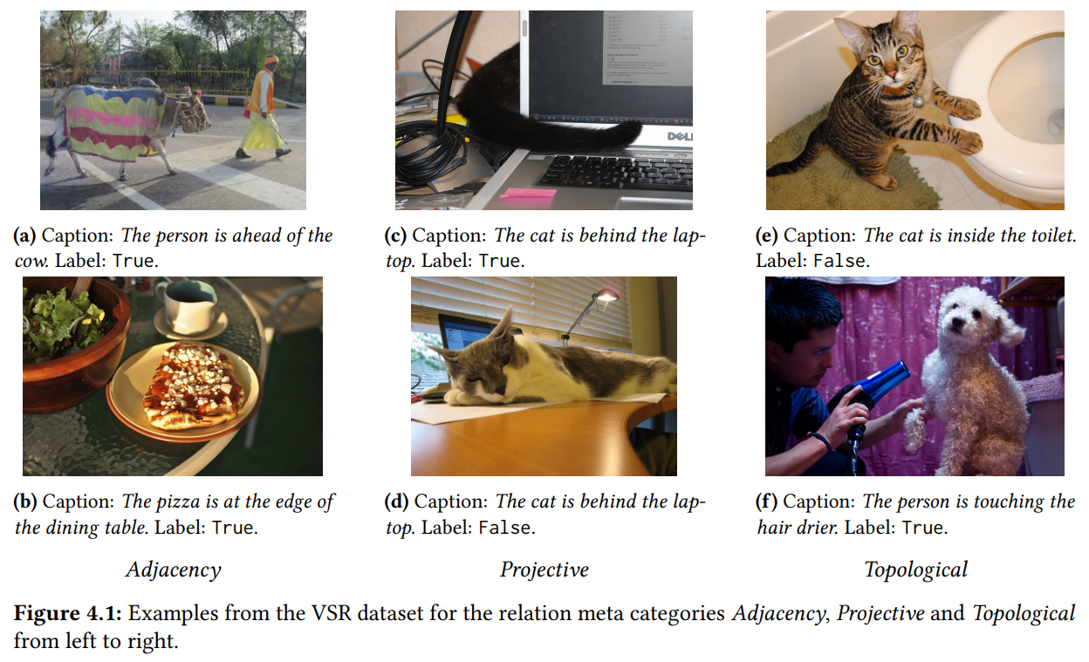

Slide 14
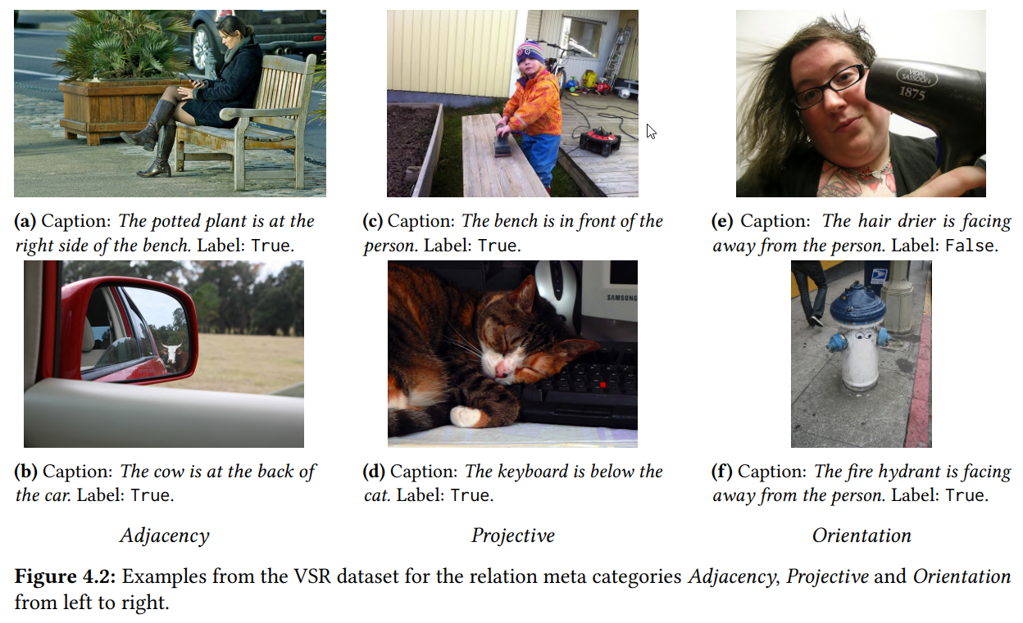

Slide 15
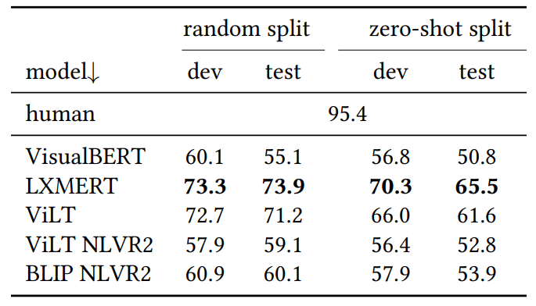
3.2 Experiments and Results
VSR authors test three popular VLMs: VisualBERT, LXMERT and ViLT
We also evaluate ViLT and BLIP fine-tuned on NLVR2
Random split: LXMERT and ViLT are the best over 70% accuracy. VisualBERT below 60%.
Zero-shot split: performance declines significantly. Best model 63%.
Compared to human performance, there is a more than 20% gap with the best models.
NLVR2 performance drop and dev/test difference is maintained.

Slide 16
3.2 Experiments and Results
Some relations are harder, regardless of training examples
Orientations and facing directions are very hard
Left and right relations are difficult
Examples can refer to either viewer’s or object’s reference frames
Orientation worst on both splits, at chance level
Proximity difficult on zero-shot, relative to concept and context

Slide 17
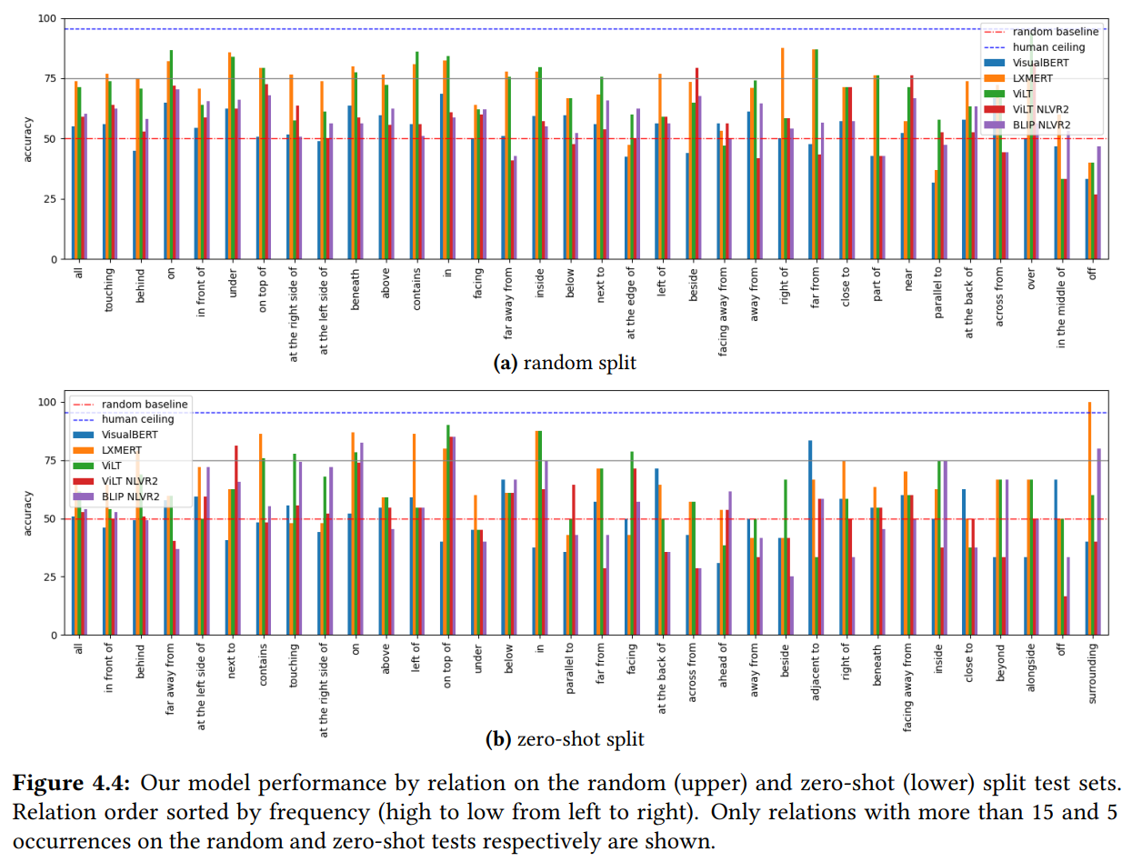

Slide 18
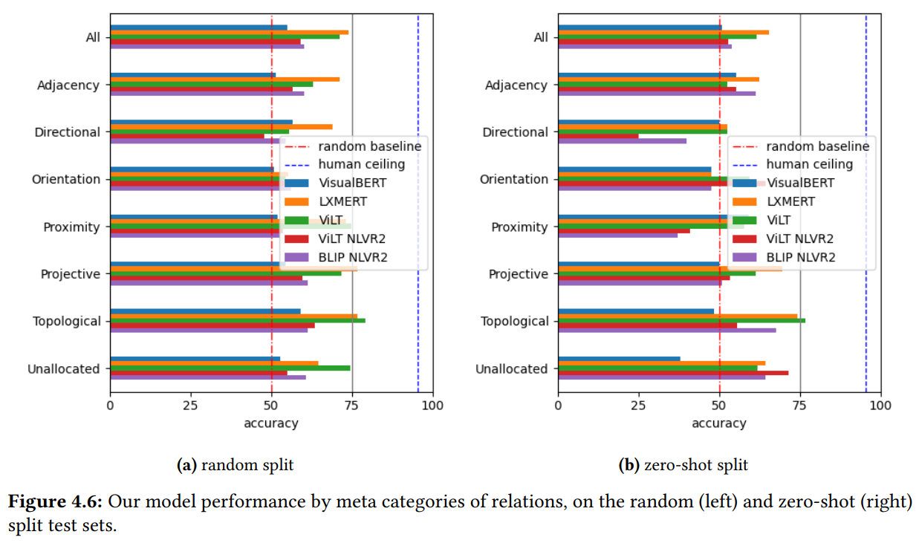

Slide 19
4 Synthetic Dataset Generation
Winoground has no training data, annotating is time-consuming
A solution could be to create a synthetic dataset for compositional reasoning
Three options: Text-to-Image Generation, Image Captioning and Image Retrieval

Slide 20
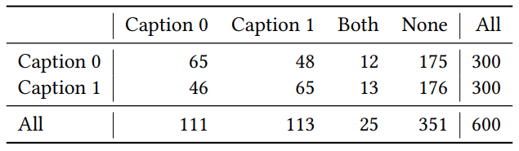
4.1 Text-to-Image Generation
We want to know if SD is good for synthetic dataset generation
Stable Diffusion to generate images from Winogroud captions
We also do a manual qualitative evaluation of the generated images
6 annotators in total and each one annotated 50 examples
Total of 300 annotated examples and 600 images
Conclusion is that SD is not good enough, most images are incorrect

Slide 21
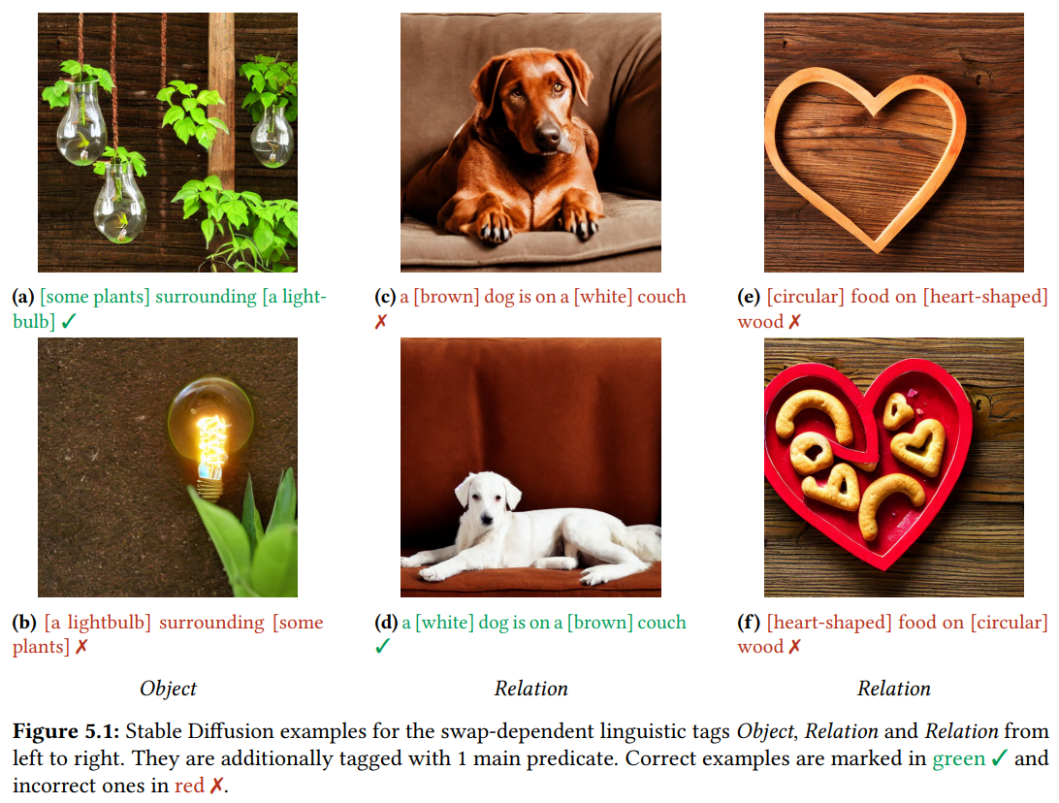

Slide 22
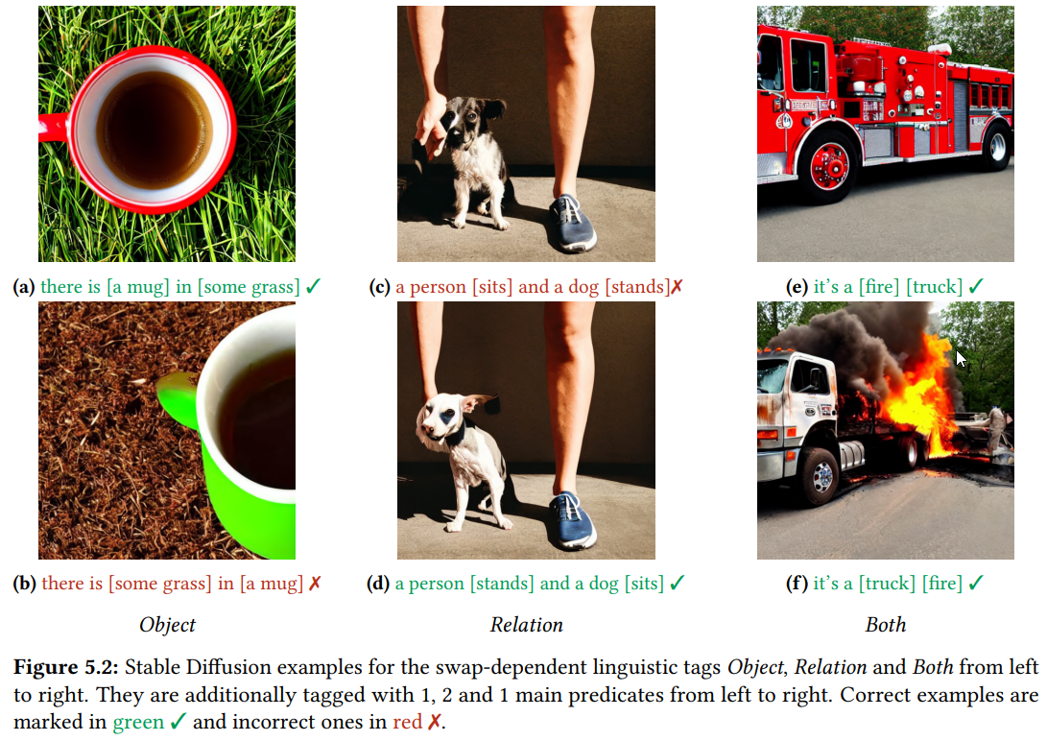

Slide 23
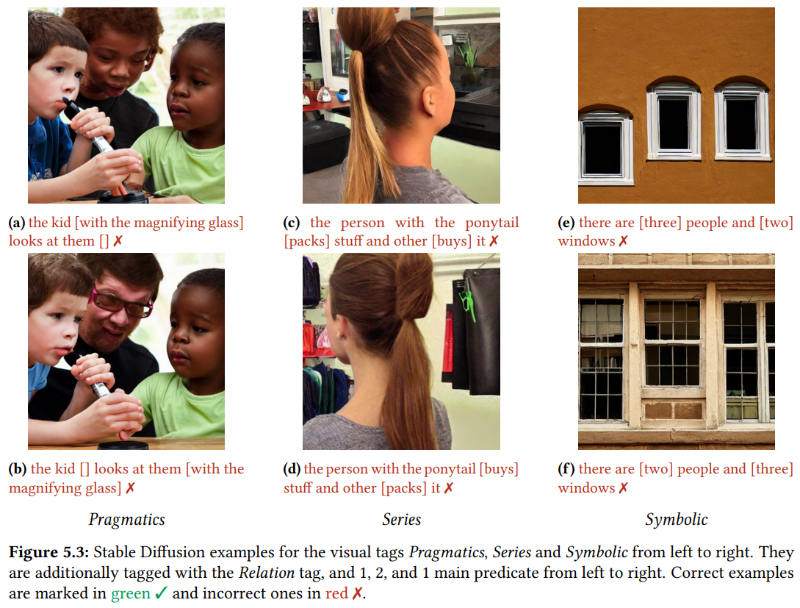

Slide 24
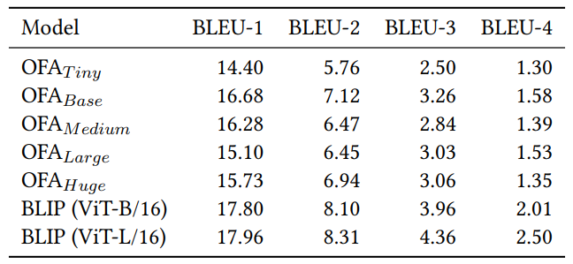
4.2 Image Captioning
We evaluate image captioning for synthetic dataset creation
OFA and BLIP models to generate captions for all Winoground images
To evaluate, we calculated the BLEU score compared to real captions
Captions are very different, but correct most of the times
Generate accurate captions much faster than human annotation

Slide 25
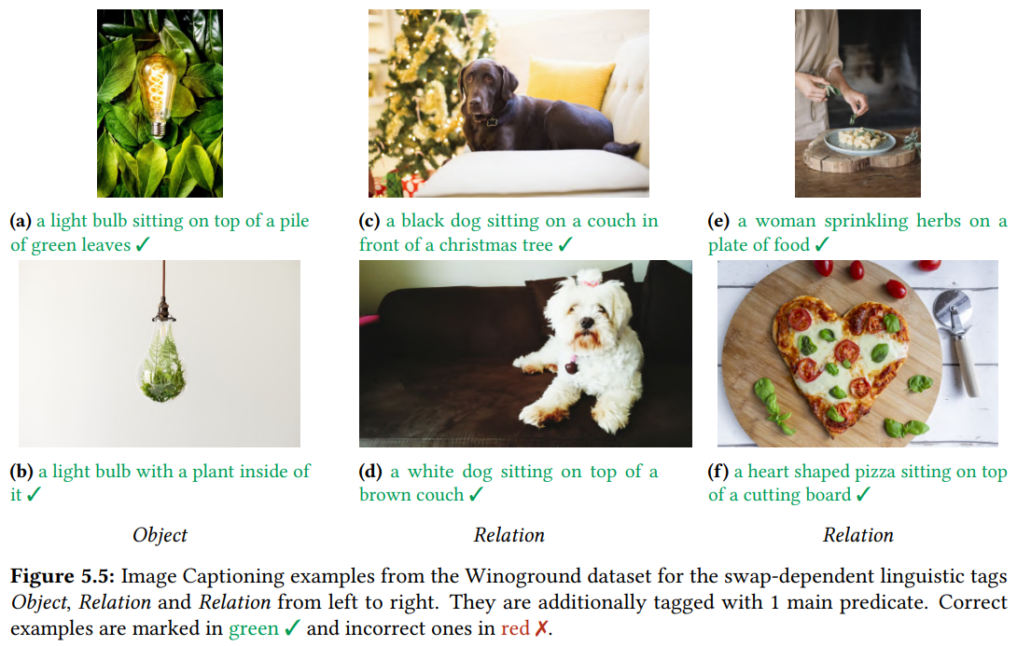

Slide 26
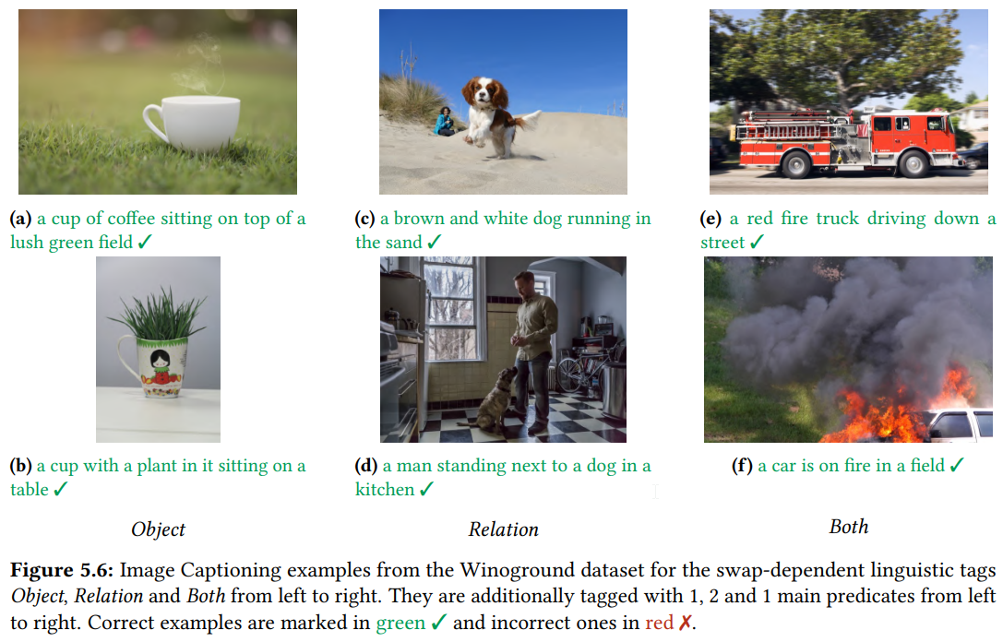

Slide 27
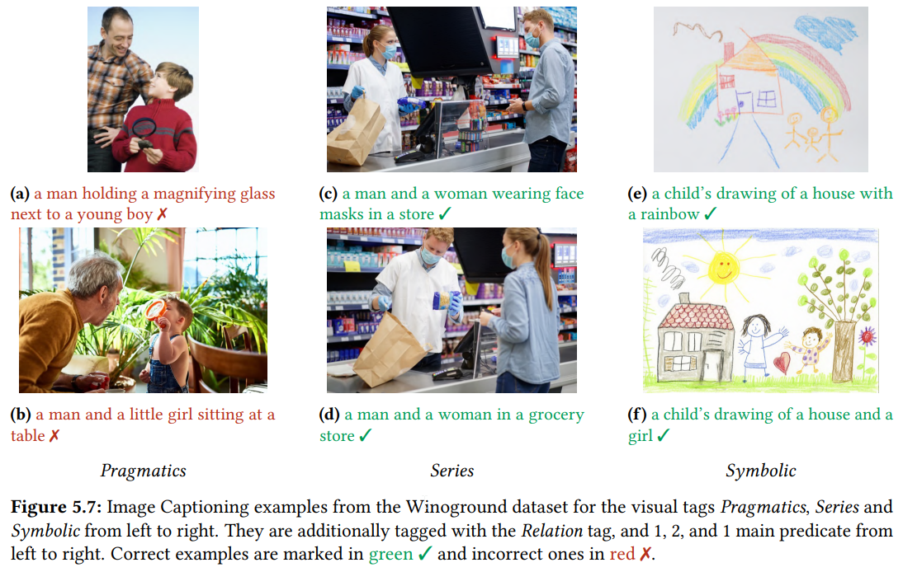

Slide 28
4.3 Image Retrieval
Retrieve images from LAION-5B using CLIP retrieval
Retrieve similar images for each Winoground caption and image
Use CLIP embedding similarity to retrieve similar images
Remove non-aesthetic, duplicate and unsafe images
Many images are wrong, would require filtering
Could be combined with image captioning
Low-effort dataset creation with minimal human work

Slide 29
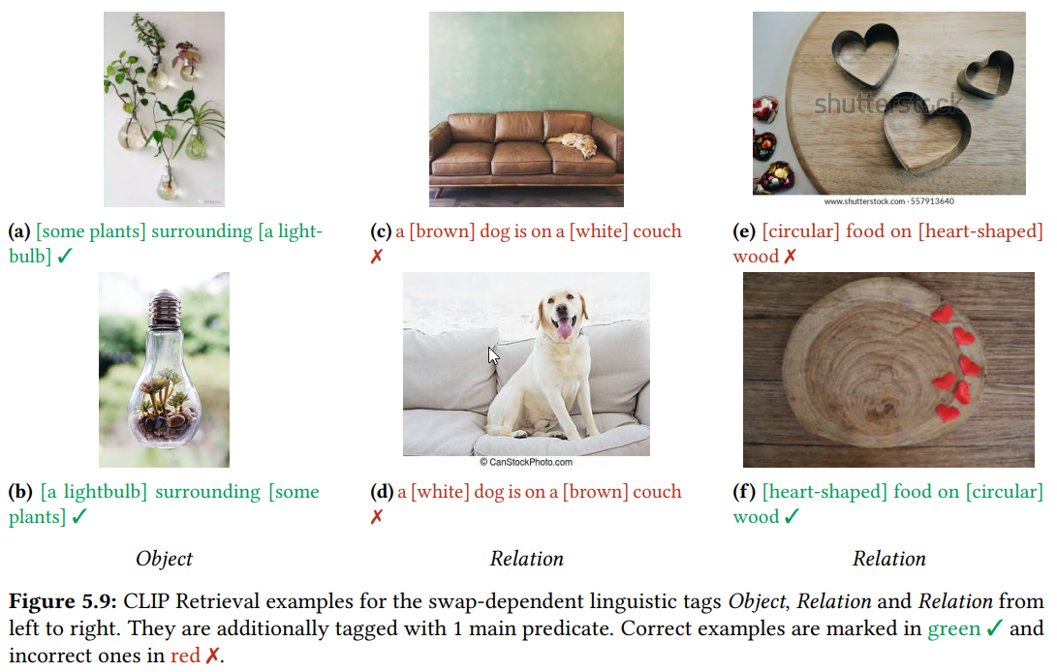

Slide 30
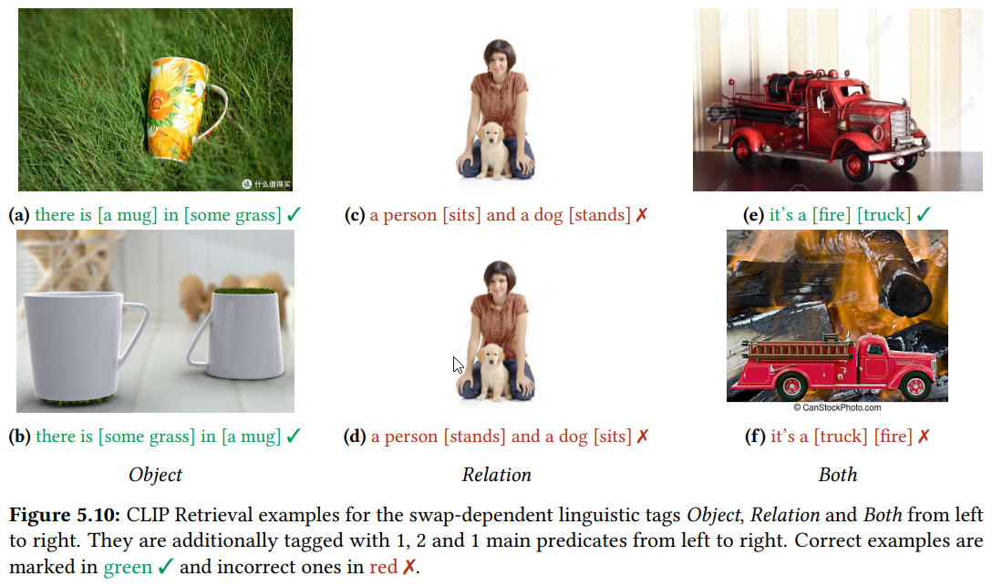

Slide 31
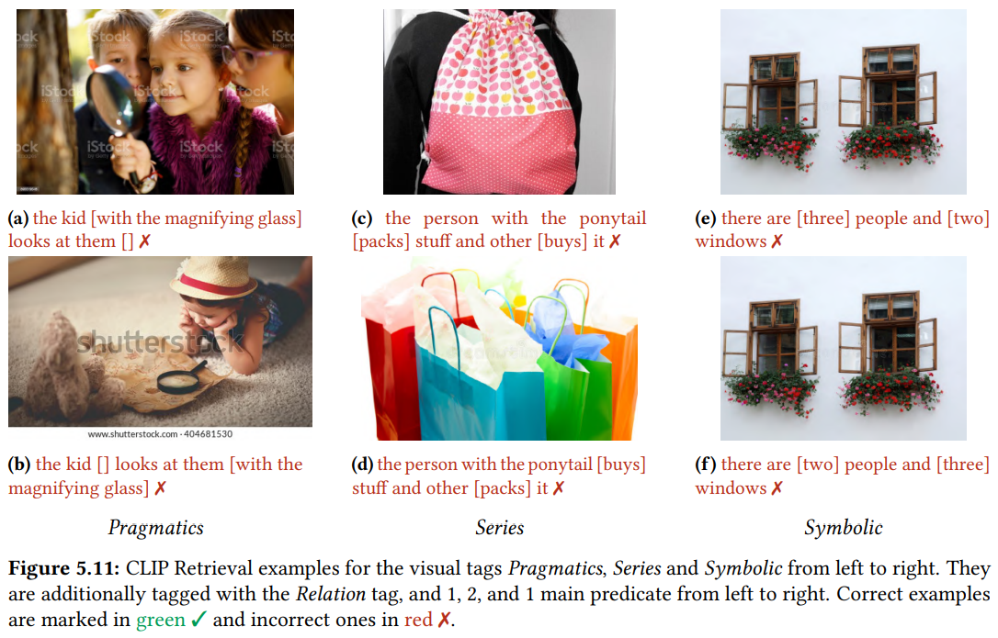

Slide 32
5 Conclusions
5 main objectives accomplished
Improve the state-of-the-art in compositional reasoning
Better than previous, still very far from humans
Perform zero-shot experiments in spatial reasoning
Zero-shot performance drop, fine-tuning necessary
Investigate text-to-image models for synthetic dataset creation
Not robust enough, a better approach needed
Investigate image captioning for synthetic dataset creation
Different but good captions, can be combined with retrieval
Investigate image retrieval for synthetic dataset creation
Many wrong images, some filtering needed

Slide 33
6 Future Work
Four additional ideas for synthetic dataset generation
Ideas for extending current datasets to be multilingual

Slide 34
6.1 Synthetic Dataset Generation
Four additional ideas: explicit verbalization, text-to-image, image-to-image and image captioning and retrieval
Use synthetic datasets to train VLMs in a self-supervised way
Use multi-tasking and multi-sourcing
Multi-tasking: learn more than one task simultaneously
Multi-sourcing: combine different synthetic datasets

Slide 35
6.1.1 Explicit Verbalization
Collect images with spatial relations (COCO)
Use an object detector to identify the entities in the images
Create verbalization templates by hand to generate captions

Slide 36
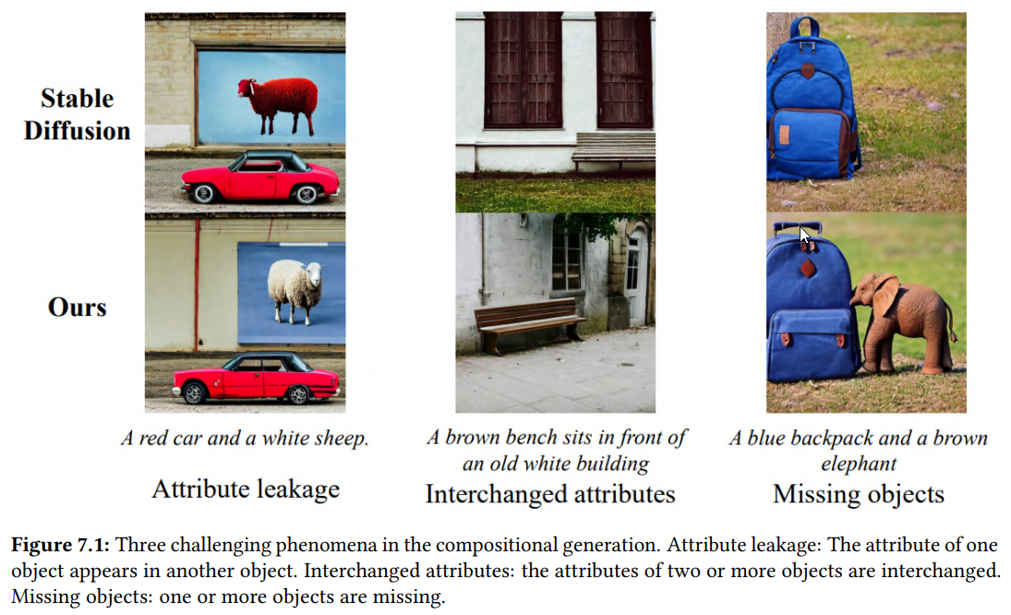
6.1.2 Text-to-Image Generation

Slide 37
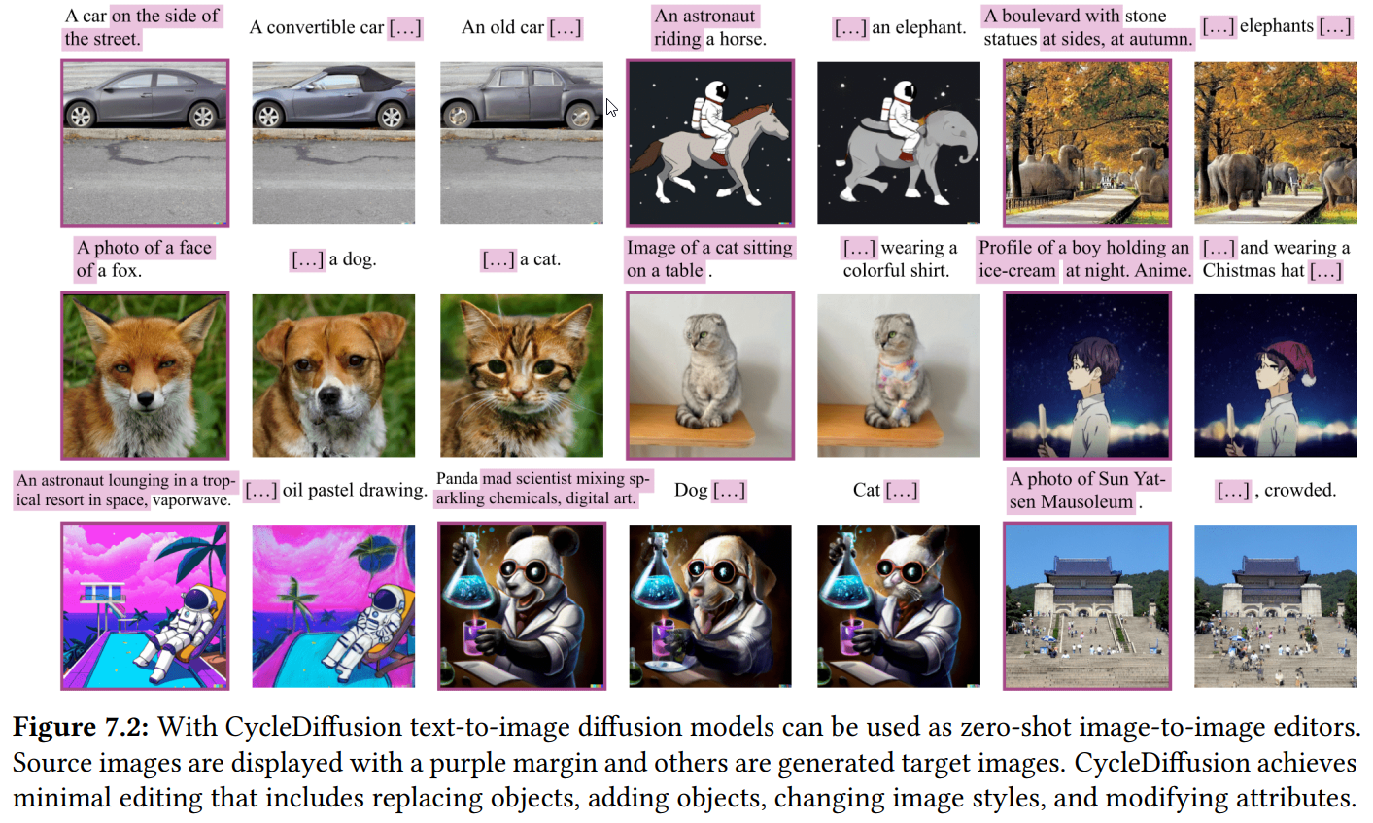
6.1.3 Image-to-Image Generation

Slide 38
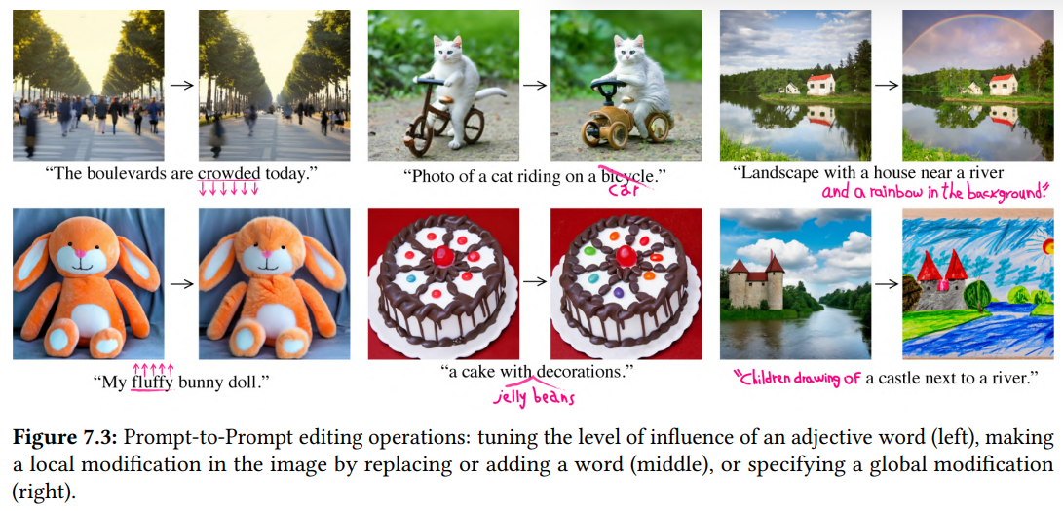
6.1.3 Image-to-Image Generation

Slide 39
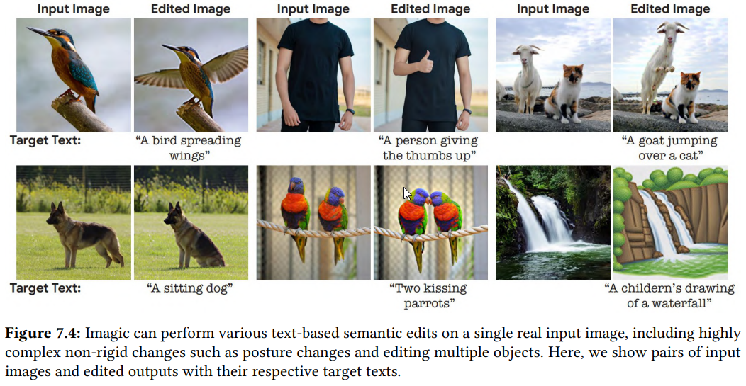
6.1.3 Image-to-Image Generation

Slide 40
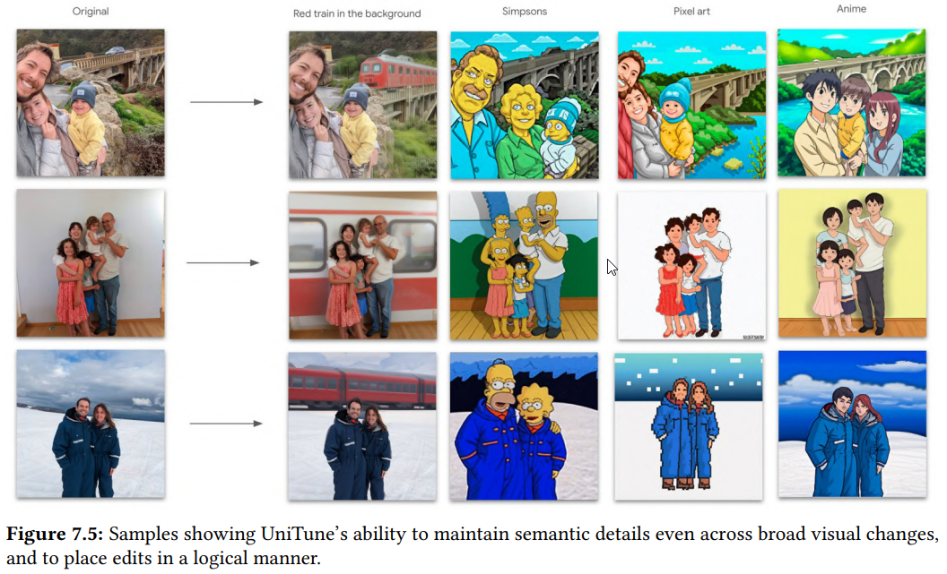
6.1.3 Image-to-Image Generation

Slide 41
6.1.4 Image Captioning and Retrieval
Retrieve images of interest from a huge dataset
Use image captioning to create a dataset
Similar example: LAION-COCO 600M
BLIP to generate captions
CLIP to rank captions
T0 to correct grammar and punctuation errors

Slide 42
6.2 Multilingual Datasets
Extend Winoground and VSR to more languages and cultures
Winoground translation difficult
Both captions must contain the same words
Very difficult, impossible in some cases
VSR translation seems easier
No word conditions
Different spatial relations across languages
Different word order in languages
Multilingual pre-training datasets
LAION-2B-multi and LAION-1B-nolang
LAION-translated

Slide 43
Thank you!

